Slide 1


3D Graphics
Workshop 8

Slide 2
Unity3D input
Unity3D has a default Input Manager to get the devices (e.g. keyboard, mouse and joysticks)
However the Input Manager does not support newer devices like various Gamepads (e.g. XBox, PS4 and Switch).
To resolve the issue, Unity3D allows developer to install an external package Input System.
https://docs.unity3d.com/Packages/com.unity.inputsystem@1.0/manual/SupportedDevices.html
Do Workshop 8 Lab 1 to learn how to install and use Input System.

Slide 3
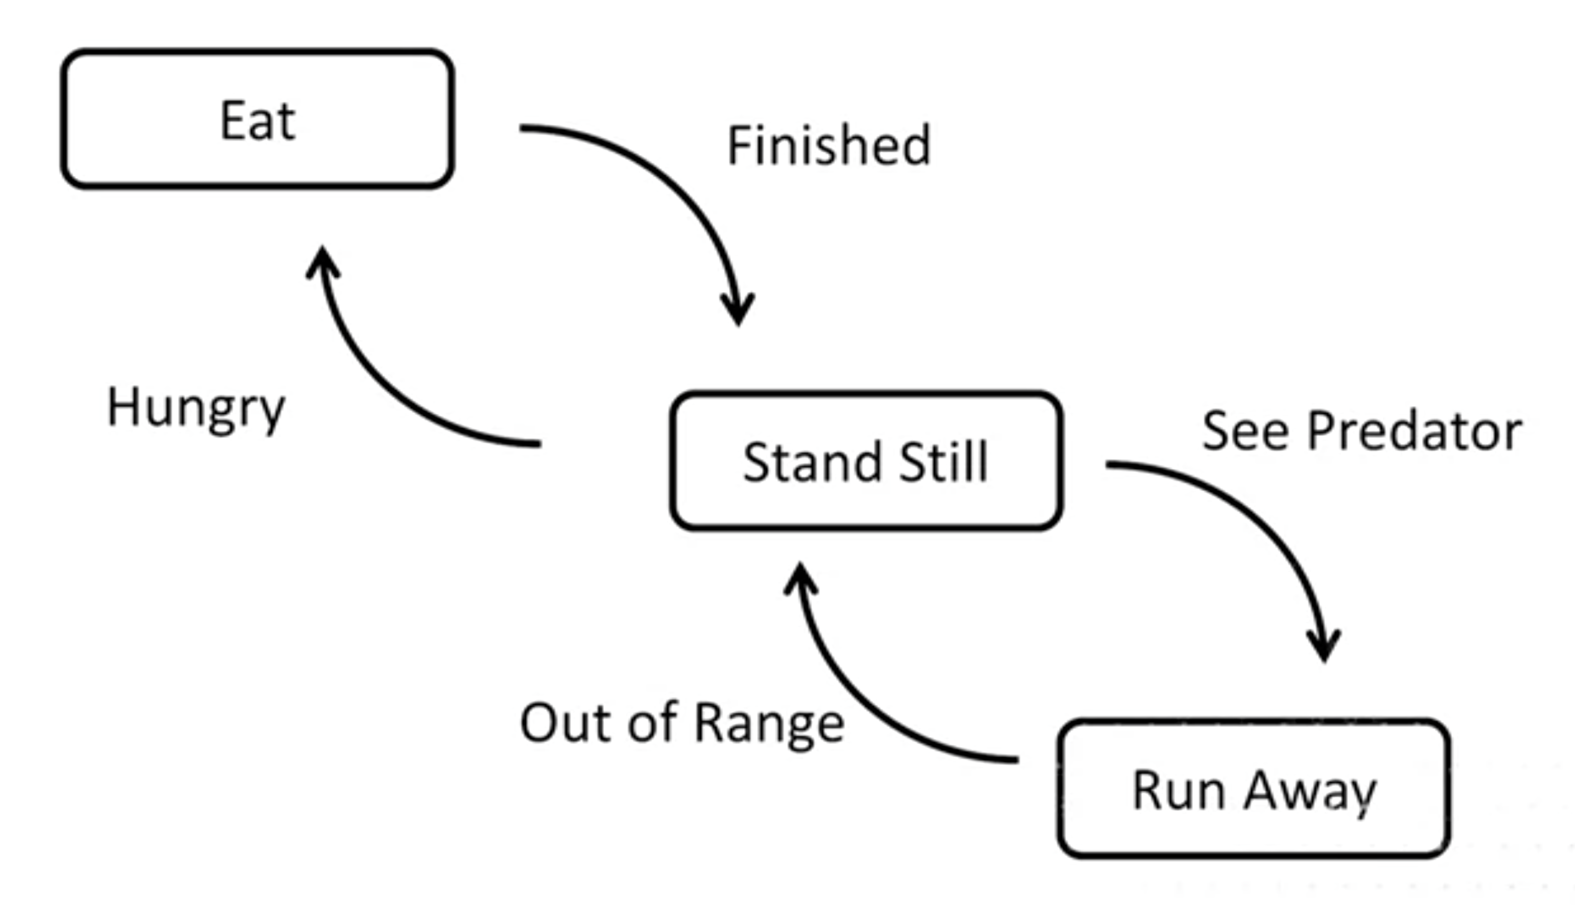
State machine
State machine diagram is a way to describe the state of an object.
In this example, we have three states: Eat, Stand Still and Run Away.
A transition move the object state from one state to another state.
For the transition to move the object state, an event must happen or a condition is true.

Slide 4
State machine
In the example.
If the player is at the Stand Still state.
It will move to Run Away state when the player saw a predator.
If the player is at Run Away state.
It will move to Stand Still state when the predator is out of range

Slide 5
State machine
In the example.
If the player is at the Stand Still state.
It will move to Eat state when the player is hungry
If the player is at Eat state.
It will move to Stand Still state when the player finish eating

Slide 6
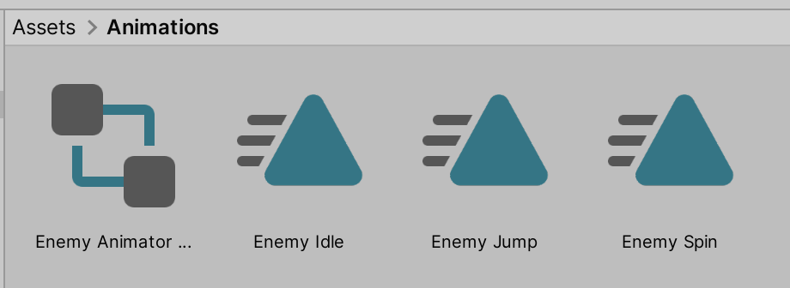
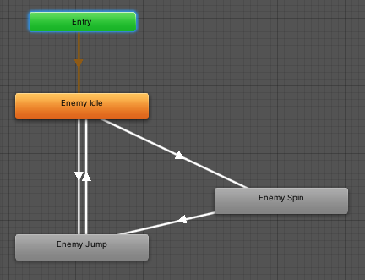
Unity3D state machine
The state machine in Unity3D resides in the Animator Controller.
Each state can be an animation.
We need to define the animation first.
We connect the states using transition.
We then specify the condition for each transition.
Thus, the game object can move from one state (animation) to another state (animation) using the specified state machine.
Do Workshop 8 Lab 2 to learn how to configure the game object animation using state machine.

